Slide 1
Encryption of Biometrics Traits to Avoid Privacy Attacks using AES Encryption
PIP104 University Project II
Final Viva - Voce
Batch Number: CSD-G30
Under the Supervision of,
Prof. Himansu Sekhar Rout
Assistant Professor
School of Information Science
Presidency University
Roll Number | Student Name
Karen Rena C | 20211CSD0169
Pavaman S Suraj | 20211CSD0126
Samprity Singha | 20211CSD0044
Name of the Program: B. Tech - CSD
Name of the HoD: Dr. Saira Banu Atham
Name of the Program Project Coordinator: Dr Manjula H M
Name of the School Project Coordinators: Dr. Sampath A K / Dr. Abdul Khadar A / Mr. Md Ziaur Rahman

Slide 2
Introduction
In recent years, biometric systems have gained significant attention as a means of enhancing security for authentication systems. With growing concerns about data breaches and cybersecurity threats, integrating biometrics with cryptographic algorithms has become critical to safeguarding sensitive information.
This project proposes a multimodal approach to develop an advanced security framework by combining biometric key generation using iris and face biometrics with the Advanced Encryption Standard (AES).By employing machine learning techniques for feature extraction.
The project aims to generate biometric keys that will secure image data through AES encryption. This ensures that the biometric keys are highly secure, unique, and difficult to replicate, making the framework ideal for high-security applications.

Slide 3
Literature Review
Biometric-based key generation in combination with AES encryption has emerged as a solution for enhancing security in cryptographic systems. Biometric cryptosystems address key management challenges by deriving unique, life-long keys directly from biometric traits such as fingerprints, iris, or face recognition. These keys offer convenience and enhanced security since they are tied to an individual's unique physical traits
One approach leverages machine learning (ML) to continuously adapt to changing biometric patterns, improving accuracy in multimodal biometric systems (using both iris and face). ML enhances system resilience, but it introduces risks such as data poisoning and potential biases in training data​

Slide 4
Literature Review
In terms of AES encryption, methods like dynamic S-box optimization and biometric-based key generation further strengthen security by introducing nonlinearity and unpredictability into the cryptographic process. However, these systems face challenges in computational complexity and longer encryption times, especially for larger datasets
By combining multimodal biometric data, optimized machine learning algorithms and optimized AES, the proposed system can improve security, efficiency, and adaptability, making it a promising solution for secure multimodal authentication.

Slide 5
Research Gaps Identified
1. Privacy and Security Concerns:
Biometric data is sensitive and irreplaceable, making systems vulnerable to breaches, spoofing, and misuse without secure storage and anti-spoofing mechanisms.
2. Computational Complexity: Current methods often have high resource requirements, making them unsuitable for low-power devices and decentralized architectures like IoT systems.
3. Latency and Real-Time Performance: Extensive computations in multimodal and deep learning-based systems introduce delays, limiting usability in real-time applications.

Slide 6
Research Gaps Identified
4. Data Quality Dependency: Variability in image quality and environmental factors reduces system accuracy, especially in uncontrolled settings, requiring robust handling of noisy or incomplete data.
5. Vulnerability to Emerging Threats: Machine learning models face risks from adversarial attacks, deepfakes, and data poisoning, highlighting the need for robust defense's against these evolving threats.

Slide 7
Proposed Methodology
1. Biometric Feature Extraction:
OpenCV: Utilized for processing and extracting features from face and iris images.
Scikit-learn: Implements machine learning models to classify and extract important features from biometric data.
Convolutional Neural Networks (CNNs): Effective for extracting features due to their capability to detect spatial hierarchies in iris and face images.
Pretrained Models: Models like VGG16, ResNet (for face recognition), and IrisNet (for iris recognition) enhance feature extraction accuracy​
2. Multimodal Fusion Techniques:
Concatenation: The simplest method of merging feature vectors from face and iris modalities into a single vector.
Dimensionality Reduction: Techniques like PCA (Principal Component Analysis) reduce the size of the concatenated feature vector while preserving essential information
3. Encryption:
Advanced Encryption Standard (AES): Implementing AES-128 or AES-256 with a dynamic S-box for improved security and integrity.
PyCryptodomex: A Python library that supports AES encryption and decryption used in the biometric cryptosystem.
Cryptography (Python): Another library that enables symmetric encryption algorithms, including AES

Slide 8
Objectives
1. Design a Multimodal Biometric System: Leverage complementary iris and face traits using fusion techniques (score-level, feature-level, and decision-level) to enhance robustness, reduce spoofing risks, and improve recognition accuracy. Implement preprocessing methods to address data quality challenges.
2. Incorporate Machine Learning for Feature Extraction and Fusion: Use advanced ML algorithms like CNNs and RNNs to adaptively extract discriminative features from biometric data. Employ intelligent fusion strategies to balance accuracy and computational efficiency, ensuring robust performance under varying conditions.
3. Integrate AES Encryption for Data Security: Dynamically generate 256-bit AES keys from biometric features to secure sensitive data, particularly image data. Optimize AES for fast and secure encryption/decryption, addressing key management concerns and ensuring system scalability for real-world applications.

Slide 9
System Design & Implementation
1. Biometric Data Acquisition:
Use MMU-Iris and CelebA datasets for iris and facial feature extraction, ensuring diversity in environmental and demographic conditions.
2. Iris Image Preprocessing: Convert iris images to grayscale, resize to 224x224 pixels, and normalize pixel values for efficient CNN-based processing.
3. Face Attribute Preprocessing: Standardize facial attributes using StandardScaler and reduce dimensionality to 10 principal components using PCA.
4. Feature Extraction: Employ VGG16 for iris feature extraction and PCA for facial feature extraction, capturing unique patterns for both modalities.

Slide 10
System Design & Implementation
5. Feature Fusion: Combine iris and facial features into a single biometric template to enhance system robustness and spoofing resistance.
6. Quantization-Based Key Generation: Normalize and quantize fused features into 16 bins, convert to binary strings, and generate a secure 256-bit AES key.
7. AES-GCM Encryption: Encrypt data using the 256-bit biometric key, producing ciphertext, a unique nonce, and an authentication tag for integrity verification.
8. User Interface with Streamlit: Provide a user-friendly platform for feature upload, dynamic generation, encryption/decryption, and customizable quantization controls.

Slide 11
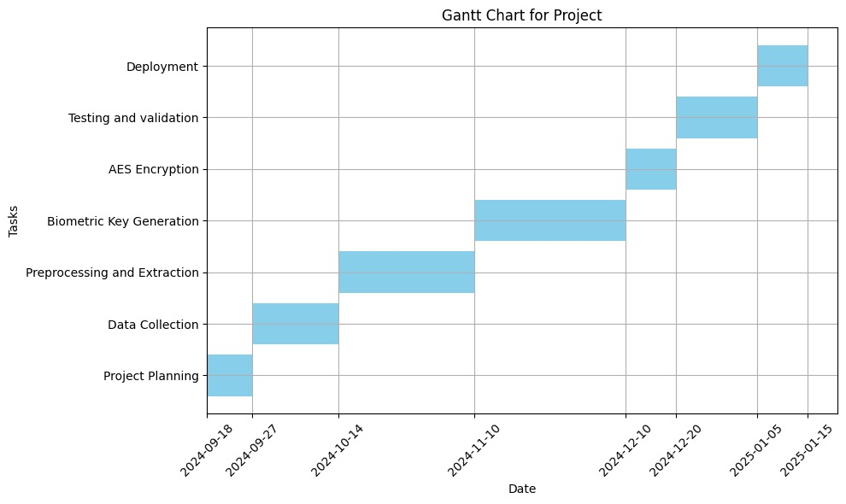
Timeline of Project

Slide 12

Results Obtained
1.Feature Extraction and Processing:
Iris Data: Preprocessed 450 iris images (shape: 224x224x3) using VGG16, generating 25088 feature embeddings per image in 263 seconds. Heatmaps illustrate discriminative feature activations.
Face Data: PCA on CelebA reduced facial features to 10 principal components, retaining 95.43% of variance.
Feature Combination: Combined iris and face features into a multimodal dataset (shape: 450x25098), ensuring robust key generation.

Slide 13
Results Obtained
2. Key Generation and Cryptographic Results:
Binary Key: Quantized biometric features into binary form for cryptographic use.
AES Key: Converted binary key into a 256-bit AES-compatible key for secure encryption. Example: AES Key (Hex): 000000000000000000000000000030000000c00000000000000d000000000000
3. AES Encryption and Decryption:
Encryption: Protected sensitive data with AES-GCM, generating ciphertext, nonce, and authentication tag. Example: Encrypted Data (Hex): ed3837c505d7707a3d174719daa204a876c7346eaa
Decryption: Successfully restored original data, ensuring confidentiality and integrity.

Slide 14
Conclusion
Key Contributions and Significance: A novel framework combining biometrics and cryptography enhances security, efficiency, and scalability, with the potential for widespread adoption in secure authentication systems.
Challenges: Dependency on high-quality biometric data and computational overhead in deep learning models present key challenges to address.
Future Scope: Expand modalities to include fingerprints and voice recognition, optimize encryption for low-power IoT devices, and address data biases for improved adaptability.

Slide 15
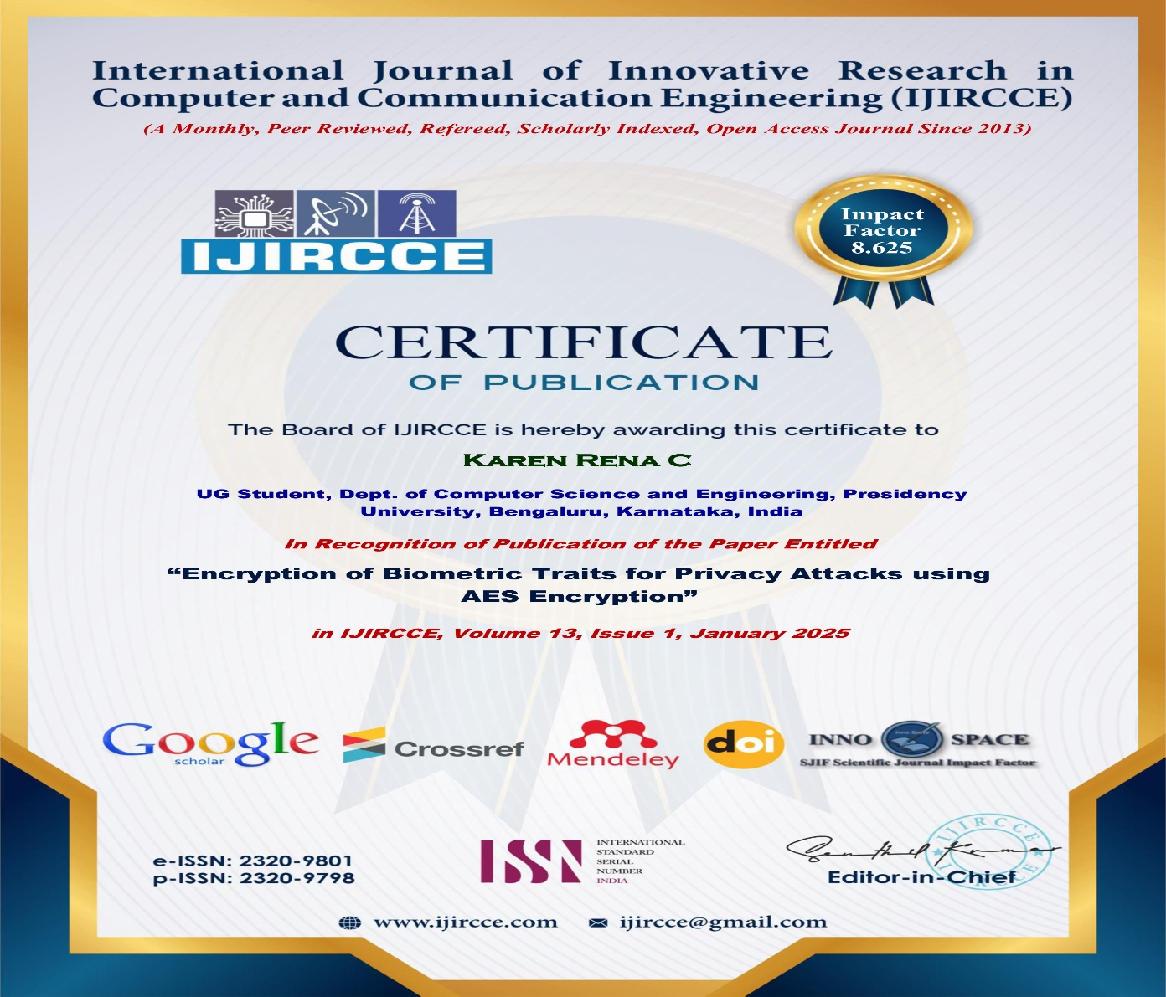
Certificates

Slide 16
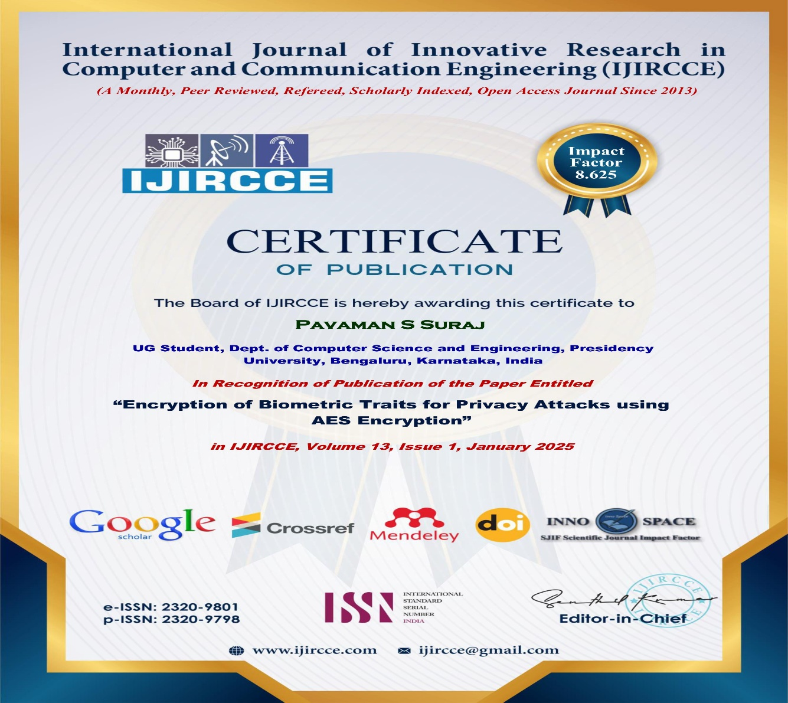
Certificates

Slide 17

Certificates

Slide 18
Mapping project with the Sustainable Development Goals (SDGs).
Goal 9: Industry, Innovation, and Infrastructure This project enhances secure digital infrastructures by combining biometric authentication, cryptography, and machine learning, addressing privacy risks and improving efficiency in industries like banking, healthcare, and transportation.
Goal 11: Sustainable Cities and Communities Biometric systems with advanced security enable secure access control in public spaces, promoting smart city initiatives and ensuring privacy-preserving authentication for digital governance and community safety.
Goal 16: Peace, Justice, and Strong Institutions The project safeguards biometric data using encryption, reducing privacy risks and fraud, thereby fostering accountability, justice, and fair access to resources in governance and legal systems.
Goal 17: Partnerships for the Goals This project promotes cross-sector partnerships by offering scalable biometric security solutions, fostering collaborations with tech companies, governments, and public institutions to advance global security and digital infrastructure.

Slide 19
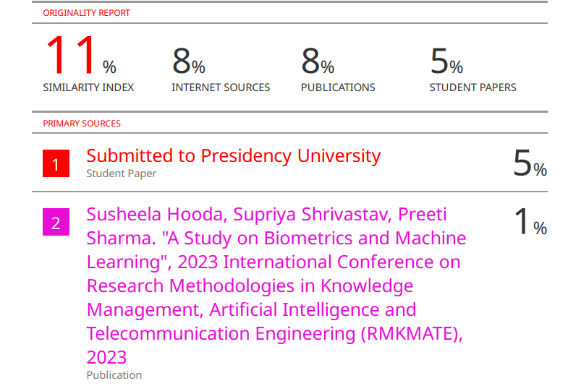
Plagiarism Report

Slide 20
References
[1] S. Nagaraj , R. Nagendra, Shanmugham Balasundaram, R. Kiran Kumar (2023). Biometric key generation and multi round AES crypto system for improved security. https://www-sciencedirect-com-presiuniv.knimbus.com/science/article/pii/S2665917423002672
[2] W. Wei and Z. Jun, Image encryption algorithm Based on the key extracted from iris characteristics, 2013 IEEE 14th International Symposium on Computational Intelligence and Informatics (CINTI), Budapest, Hungary, 2013, pp. 169-172. https://ieeexplore.ieee.org/document/6705185
[3] Ramisetty, Srividya & B., Ramesh. (2019). Implementation of AES using biometric. International Journal of Electrical and Computer Engineering (IJECE). http://doi.org/10.11591/ijece.v9i5.pp4266-4276
[4] S. Pooja, C. V. Arjun and S. Chethan, "Symmetric key generation with multimodal biometrics: A survey," 2016 International Conference on Circuits, Controls, Communications and Computing (I4C), Bangalore, India, 2016, pp. 1-5. https://ieeexplore.ieee.org/document/8053273
[5] Rachana Veerabommala, Greeshma Arya, 2022, Design And Implementation of AES Algorithm with Biometric Key Schedule to Improve Security, (IJERT) Volume 11, Issue 06 (June 2022) https://www.ijert.org/design-and-implementation-of-aes-algorithm-with-biometric-key-schedule-to-improve-security
[6] Ghilom, Milkias & Latifi, Shahram. (2024). The Role of Machine Learning in Advanced Biometric Systems. Electronics. 13. 2667. https://doi.org/10.3390/electronics13132667
[7] Hooda, Susheela & Shrivastav, Supriya & Sharma, Preeti. (2023). A Study on Biometrics and Machine Learning. 1-5. https://ieeexplore.ieee.org/document/10368885
[8] Praveen, s & Vellela, Sai Srinivas & Ramachandran, Balamanigandan. (2024). SmartIris ML: Harnessing Machine Learning for Enhanced Multi-Biometric Authentication. https://www.researchgate.net/publication/378439449_SmartIris_ML_Harnessing_Machine_Learning_for_Enhanced_Multi-Biometric_Authentication

Slide 21
Thank You

